Slide 1
Comprehensive Digital Marketing Project Work

Slide 2
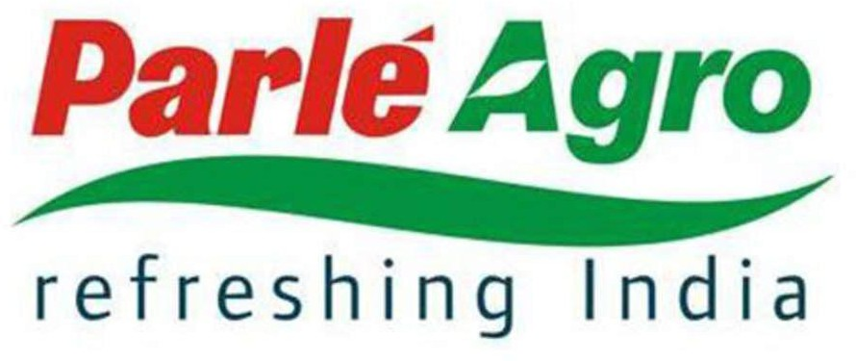

Slide 3
Part 1: Brand study, Competitor Analysis & Buyer’s/Audience’s Persona

Slide 4
Part 1: Brand study, Competitor Analysis & Buyer’s/Audience’s Persona
BRAND STUDY -
Research Brand Identity:
Logo: The Parle Agro logo was a significant aspect of its brand identity. It featured the company's name "Parle Agro" in a stylized font. The logo was usually accompanied by a unique symbol or design element that represented the brand's connection to nature, freshness, and refreshment.
Color Palette: The brand's color palette typically included vibrant and refreshing colors to reflect the essence of its products. This may include shades of green, yellow, orange, and blue, often associated with natural elements and freshness.
Packaging: Parle Agro's packaging design played a crucial role in establishing its brand identity on the shelves. The packaging was often visually appealing, with a focus on the use of bright colors, attractive graphics, and product images.

Slide 5
Slogan: Slogans are an essential part of brand identity, and Parle Agro might have used catchy and memorable taglines that resonated with consumers. These slogans were crafted to reinforce the brand's mission and values, creating a strong brand recall.
Product Range: Parle Agro's product range mainly consisted of refreshing and innovative beverages, such as fruit juices, fruit-based drinks, and carbonated beverages. Each product typically had its unique identity while aligning with the overall brand image.
Communication Style: The brand's communication style likely reflected its youthful, energetic, and dynamic personality. Marketing campaigns, advertisements, and social media interactions would have been designed to engage with the target audience effectively.
Brand Associations: Parle Agro might have associated itself with popular events, sponsorships, or brand ambassadors that complemented its brand values and targeted the desired consumer segments.

Slide 6
2. MISSION/VALUES :-
Delivering Quality Products: Parle Agro aims to provide high-quality, safe, and nutritious
fruit-based beverages to its customers. They strive to maintain the utmost standards in product development, manufacturing, and distribution.
Innovation and Diversification: The company has been driven by a spirit of innovation, consistently introducing new and unique beverage offerings to cater to changing consumer preferences. Diversification into different segments of the beverage industry may also be part of their mission.
Sustainability: Parle Agro may emphasize sustainability and environmental responsibility as part of its mission. This could include efforts to minimize their ecological footprint, support local communities, and adopt eco-friendly practices.
Consumer Satisfaction: Like any successful company, Parle Agro likely places a strong focus on customer satisfaction. Meeting and exceeding consumer expectations with their products and services is probably a key mission component.
Market Leadership: As a leading player in the Indian beverage market, Parle Agro may strive to maintain its market leadership position and continue expanding its presence nationally and potentially internationally.

Slide 7
3. UNIQUE SELLING PROPOSITIONS :-
The company's unique selling propositions (USPs) may include the following:
Diverse product portfolio: Parle Agro offers a wide range of products, including fruit-based beverages, packaged drinking water, and snacks. This diverse portfolio allows the company to cater to different consumer preferences and market segments.
Focused on health and wellness: Parle Agro has positioned some of its products as healthier alternatives by using natural ingredients and real fruit extracts. This approach appeals to health-conscious consumers seeking nutritious options in their food and beverage choices.
Innovation and product development: The company has a reputation for continuous innovation and product development. They frequently introduce new flavors and variants to stay relevant in a competitive market and cater to changing consumer preferences.
Strong distribution network: Parle Agro has an extensive distribution network, ensuring that its products are widely available across various regions in India and beyond. This wide reach allows them to penetrate different markets effectively.
Established brand reputation: Parle Agro is a part of the larger Parle Group, a
well-established brand in the Indian FMCG (Fast Moving Consumer Goods) sector.

Slide 8
ANALYSE BRAND MESSAGING :-
Brand messaging is the strategic communication that companies use to convey their brand's value, personality, and offerings to their target audience. Here are some key elements of Parle Agro's brand messaging:
Refreshing and Fun: Parle Agro's messaging often focuses on the refreshing and fun nature of their products. They position their beverages, especially Frooti and Appy Fizz, as enjoyable and light-hearted options, which resonate well with the youth and young adults.
Natural and Healthy: Parle Agro has emphasized the natural fruit flavors in their beverages, particularly in Frooti. The brand has leveraged the appeal of real fruit content to position its products as healthier alternatives to carbonated soft drinks.
Bold and Energetic: Parle Agro's brand messaging tends to be bold and energetic, reflecting the vibrant colors and packaging of their products. This approach aims to capture the attention of consumers in a competitive market and make the brand stand out.
Celebrity Endorsements: In the past, Parle Agro has used celebrity endorsements to strengthen its brand messaging. Popular Bollywood actors and sports personalities have been associated with their products, enhancing their appeal and reach.

Slide 9
Innovation and Uniqueness: The company has also highlighted the uniqueness of its products, especially Appy Fizz, which was one of the first sparkling fruit juice drinks in India. Emphasizing innovation helps Parle Agro differentiate itself from competitors.
Emotional Connect: Brand messaging often plays on emotional connect, targeting nostalgia and memories associated with Frooti, which has been a beloved beverage for generations of Indians.
Environmental Consciousness: As environmental concerns gained prominence, Parle Agro also started emphasizing its efforts towards sustainable practices, including recyclable packaging and responsible sourcing of ingredients.
EXAMINE THE BRAND’S TAGLINE :-
The tagline of a product is a short and memorable phrase or slogan that is used in marketing and advertising to convey the essence or key message of the product. It is often a catchy and powerful statement designed to capture the attention of consumers and create a positive association with the product. Parle Agro has used the following taglines for its various products
:-
Frooti - "Mango Frooti, Fresh and Juicy"
Appy Fizz - "Life Ko Refresh Karo"
Bailley - "Pure and Safe"
Frio - "Recharge with Frio"
Saint Juice - "Live Healthy, Juicy Fresh"
Grappo Fizz - "Get Addicted"
Hippo - "Hungry Kya?"

Slide 10
B. COMPETITOR ANALYSIS :-
A competitor analysis involves assessing the strengths and weaknesses of competing companies within the same industry to gain insights into their strategies and identify opportunities for your own business. Here's a general framework for conducting a competitor analysis:
Identify Competitors: Begin by identifying the key competitors of Parle Agro in the industry. This may include well-known beverage and food companies such as Coca-Cola, PepsiCo, Dabur, ITC Limited, etc.
Gather Information: Research and collect data on each competitor's products, market share, financial performance, target market, distribution channels, pricing strategies, marketing campaigns, and recent news or developments. Annual reports, company websites, industry publications, and news articles can be valuable sources of information.
Analyze Products and Services: Compare Parle Agro's products and services with those of its competitors. Assess the unique selling points (USPs) of each product, packaging, quality, and any innovations or new product launches.
Market Share: Analyze the market share of each competitor to understand their position in the industry and their relative strength compared to Parle Agro.

Slide 11
Financial Performance: Study the financial statements of each competitor to evaluate their revenue growth, profitability, and overall financial health. This will give you an idea of their capacity for investments and expansions.
Target Market and Customers: Determine the target market of each competitor and the customer segments they are focusing on. Evaluate their marketing strategies to appeal to these customer segments.
Distribution Channels: Understand the distribution channels used by each competitor to reach their customers. This includes retail presence, online sales, and partnerships with distributors or retailers.
Pricing Strategy: Analyze the pricing strategies of each competitor and how they position their products in terms of pricing.
Strengths and Weaknesses: Identify the strengths and weaknesses of each competitor. Understand what sets them apart from Parle Agro and where they might be lacking.
Opportunities and Threats: Based on the analysis, identify potential opportunities and threats for Parle Agro in the market. This can help in developing strategies to capitalize on opportunities and mitigate threats.

Slide 12
SWOT Analysis: Consolidate the information gathered and conduct a SWOT analysis for Parle Agro to understand its internal strengths and weaknesses as well as external opportunities and threats.
Marketing and Advertising: Evaluate the marketing and advertising efforts of each competitor, including social media presence, endorsements, promotions, and campaigns.
COMPETITOR 1 :-
Coca-Cola India: Coca-Cola is a global beverage giant with a strong presence in the Indian market, offering a wide range of soft drinks, juices, and other non-alcoholic beverages. Some of their popular brands include Coca-Cola, Thums Up, Maaza, and Minute Maid.
COMPETITOR 2 :-
PepsiCo India: PepsiCo is another major multinational player in the Indian beverage industry. They have a diverse portfolio of beverages and snacks, including Pepsi, Mirinda, 7UP, Slice, and Tropicana, which competes directly with Parle Agro's Frooti and Appy.
COMPETITOR 3 :-
Dabur: Dabur is an Indian consumer goods company that also competes with Parle Agro in the fruit-based beverage segment. Their products include Real fruit juices, Real Activ, and Real Wellnezz, among others.

Slide 13
C. BUYER’S / AUDIENCE’S PERSONA :-
A buyer persona is a fictional representation of your ideal customer, based on market research and data about your target audience. It helps businesses understand their customers' needs, preferences, and behaviors, allowing them to tailor their marketing strategies and product development to better serve their audience. The specifics of a buyer persona can vary depending on the product and industry.
Parle Agro is a well-known Indian beverage company with a diverse product portfolio that includes popular brands such as Frooti, Appy Fizz, and Bailley. To define the audience's/buyer's persona for Parle Agro, we'll consider the typical characteristics of the target consumers based on their product offerings and market presence :-
Demographics:
Age: Parle Agro's products cater to consumers of various age groups, with a particular focus on the youth and young adults.
Gender: The products are targeted towards both male and female consumers.
Location: Parle Agro products have a nationwide presence in India, with a strong emphasis on urban and semi-urban areas.
Lifestyle and Interests:
Urban Dwellers: Parle Agro's primary market lies in urban and semi-urban areas, where the majority of its consumers lead fast-paced lives.
Youthful and Trendy: Their products often appeal to consumers who enjoy modern, trendy, and innovative offerings.

Slide 14
Behavior and Buying Habits:
Convenience Seekers: Consumers who prefer ready-to-drink beverages that are easily accessible and can be consumed on-the-go.
Brand Loyalty: Parle Agro has a strong brand presence and loyalty, which attracts repeat customers.
Social Media Users: Their target audience is likely to be active on social media platforms, making digital marketing an effective channel to reach them.
Budget:
Middle-Class and Aspirational: Parle Agro products are generally priced affordably, making them accessible to the middle-class population and aspirational younger consumers.
Occasions:
Everyday Consumption: Their beverages, like Frooti and Appy Fizz, are suitable for regular consumption and are often enjoyed during casual occasions.
Celebratory Events: Some products like Appy Fizz may be preferred during celebratory events due to their fizz and fruit flavor.

Slide 15
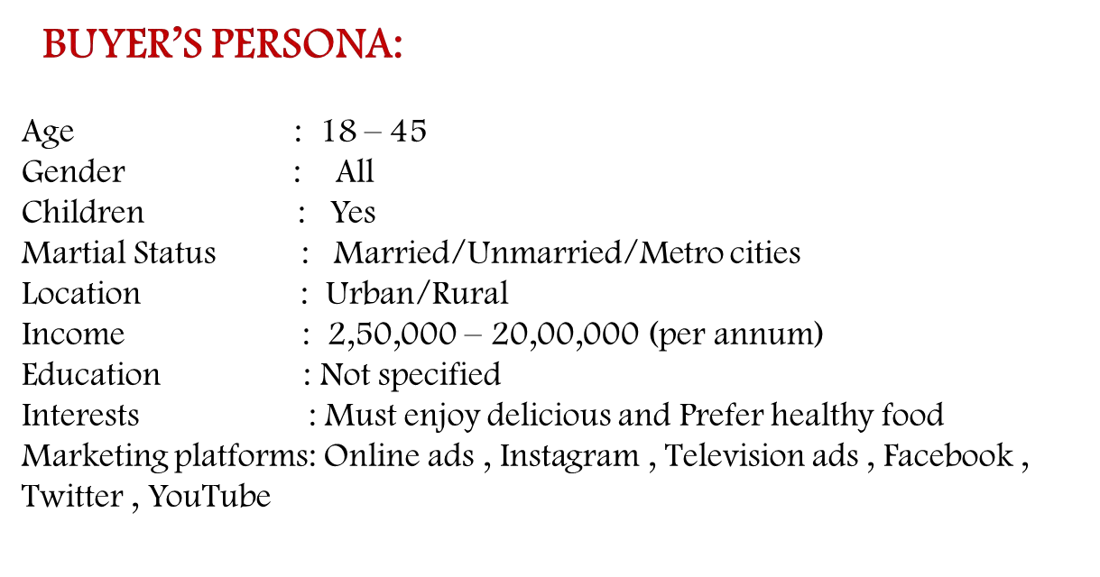


Slide 16
TARGET AUDIENCE
The company's target audience can be broadly categorized into the following groups:
Children and Youth: Parle Agro's fruit-based beverages are popular among children and young adults due to their fruity flavors and attractive packaging. The company often employs marketing strategies that appeal to this demographic, including endorsements by popular youth icons and engaging digital campaigns.
Urban Consumers: Parle Agro's products have a strong presence in urban areas, where consumers are more inclined towards packaged beverages and convenience foods. The company targets urban dwellers who seek refreshing and convenient drink options.
Health-Conscious Consumers: With a focus on fruit-based beverages, Parle Agro also targets health-conscious consumers who prefer natural and fruit-based alternatives over carbonated soft drinks. Their products are often marketed as healthier options compared to other sugary beverages.
Middle-Income Consumers: Parle Agro's pricing strategy positions its products as affordable for a wide range of consumers, particularly middle-income households.
Mass Market: The company aims to capture a significant share of the mass market in India, which includes people from various demographic backgrounds and age groups.
Summer Season Buyers: Due to the refreshing nature of their products, Parle Agro experiences higher sales during the summer season when demand for such beverages tends to rise.

Slide 17
Part 2: SEO & Keyword Research

Slide 18
SEO AUDIT: An SEO audit refers to the process of evaluating and analyzing a website's search engine
optimization (SEO) performance and identifying areas for improvement. The primary goal of an SEO
audit is to assess the website's overall health and effectiveness in terms of organic search visibility,
ranking, and traffic generation.
During an SEO audit, various aspects of the website are examined, including:
★ On-Page SEO: This involves analyzing the content, keywords, meta tags, headings, URL structure,
and internal linking to ensure they are optimized for search engines and relevant to the target
audience.
★ Technical SEO: This focuses on the website's backend elements, such as site speed,
mobile-friendliness, crawlability, indexation, and XML sitemaps. Technical issues can significantly
impact a site's search rankings and user experience.
★ Off-Page SEO: The audit may also assess the website's backlink profile, evaluating the
quality and quantity of inbound links. High-quality backlinks from reputable websites can
positively influence a site's search rankings.
★ Site Architecture: The structure of the website, including its navigation and information
hierarchy, is examined to ensure it is user-friendly and search engine-friendly.

Slide 19
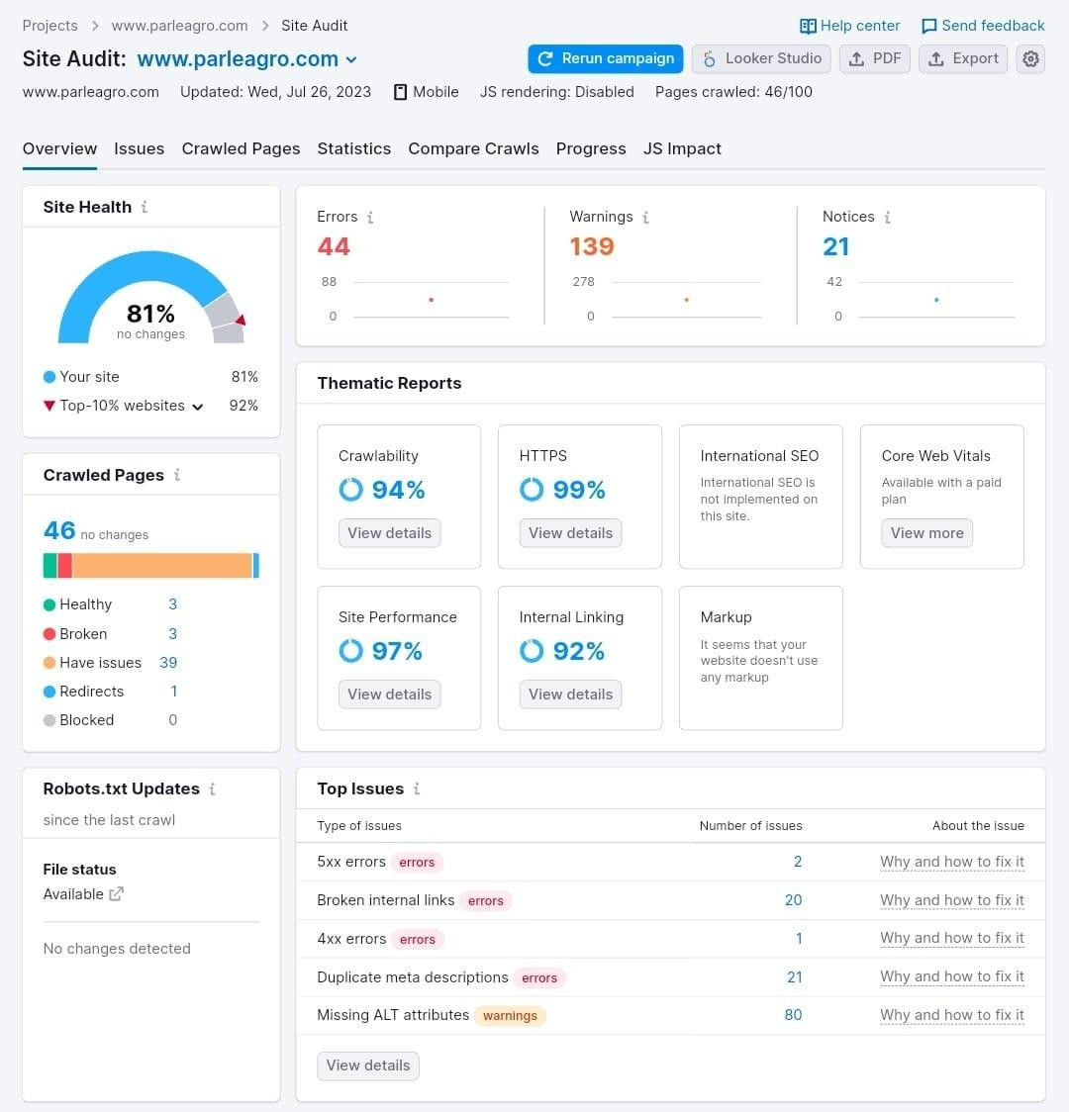

Slide 20
KEYWORD RESEARCH:
Keyword research is a crucial process in digital marketing and search engine optimization (SEO) It involves identifying the specific words and phrases that people use when searching for information, products, or services on search engines like Google, Bing, or Yahoo.
Keyword research for Parle Agro, here are some potential keywords and topics
related to the company:
Parle Agro: The main brand name itself is an essential keyword for the company.
Frooti: Frooti is one of Parle Agro's most famous products, and it is a
well-known mango-flavored drink in India. Keywords related to Frooti might include "Frooti drink," "Frooti flavors," "Frooti bottle," etc.
Appy Fizz: Appy Fizz is another popular product from Parle Agro, known for its sparkling apple juice. Keywords could include "Appy Fizz bottle," "Appy Fizz flavors," "Appy Fizz price," etc.

Slide 21
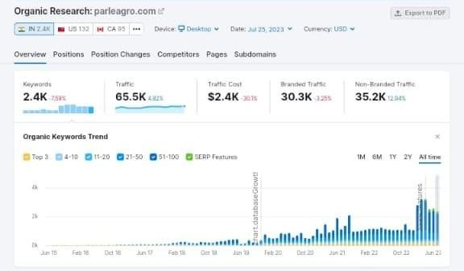
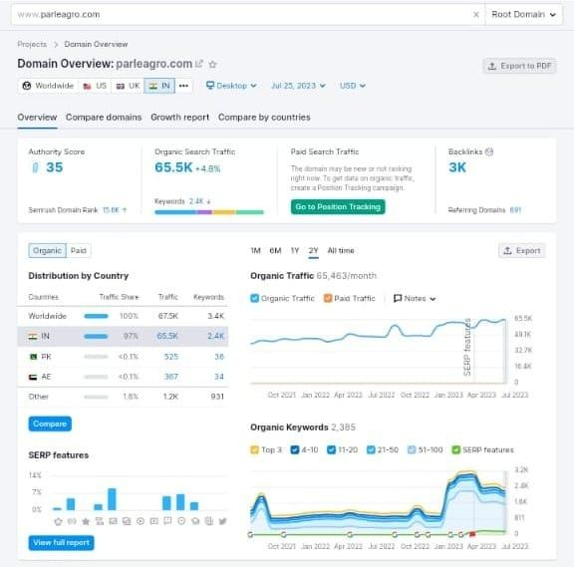
Keyword research : -

Slide 22
Part 3: Content Ideas and Marketing Strategies

Slide 23
CONTENT IDEAS :To create effective content ideas and marketing strategies for Parle
Agro, it's essential to focus on the company's target audience, product offerings, and
brand identity. Here are some content ideas and marketing strategies that could be
beneficial :
Product Demonstrations: Create engaging videos showcasing the various Parle Agro products and their usage in real-life scenarios. This can help potential customers understand the benefits and versatility of the products.
Behind-the-Scenes: Offer a sneak peek into the manufacturing process of Parle Agro's beverages. This type of content can build trust and transparency with the audience.
User-Generated Content (UGC) Campaigns: Encourage customers to share their experiences, photos, and videos with Parle Agro products on social media. Curate and feature the best UGC on the company's official channels.
Seasonal and Festive Content: Develop content around different seasons and festivals to align with customer preferences and promote gifting and celebration with Parle Agro beverages.

Slide 24

INTRODUCTION :
Parle Agro Private Limited (stylised as Parlé Agro) is an Indian company that owns Frooti, Appy, LMN, Hippo and Bailley brands.Parle Agro Pvt. Ltd operates under three major business verticals :
Beverages – fruit drinks, nectars, juice, sparkling drinks
Water – packaged drinking water
Foods – confectionery, snacks
BEVARAGES :
Frooti
Launched in 1985, Frooti was India's only beverage sold in a Tetra Pak packaging at the time. It went on to become the largest selling Mango drink in the country. Frooti's website has some Frooti mocktail recipes on their website.
Appy
Appy Classic was launched in 1986 as an apple nectar and originally available in a white Tetra Pak packaging with an apple and leaf graphic. As of 2011, it comes in black Tetra Pak packaging. It was the first apple nectar to be launched in India.

Slide 25
Appy Fizz
Launched in 2005, Appy Fizz is India's first sparkling apple drink available in a champagne shaped PET bottle.
Saint Juice
Launched in 2008, Saint Juice is available in three variants – Orange, Mixed fruit, Grape and Apple. At the time of its launch, its USP was "100% juice with no added color, sugar or preservatives".
LMN
LMN was launched in March 2009, as non-carbonated lemon drink (nimbu paani or lemonade).
Grappo Fizz
Launched in 2008, Grappo Fizz is a sparkling grape juice drink. Grappo Fizz is along the lines of Parle Agro's existing product Appy Fizz.
Dhishoom
In 2012, Parle Agro launched India's first Jeera Masala Soda, Dhishoom.
Frio
Frio is a range of flavoured carbonated drinks. It is currently available in 3 flavours – Lemon, Orange, and Cola.
Cafe Cuba
Launched on 19 May 2013, Cafe Cuba is a carbonated Cuban coffee, more of a bottled Espresso.
Flavour: Strong Coffee with little sugar.

Slide 26
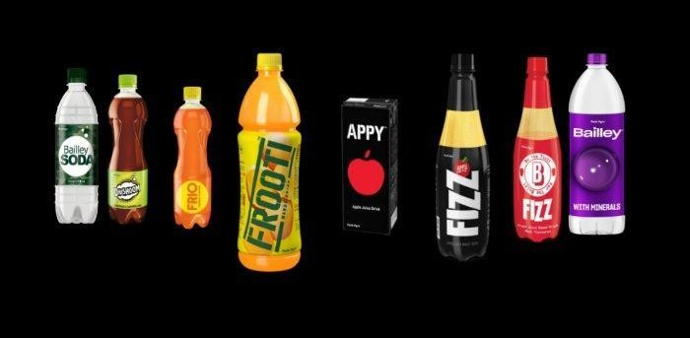
Bailley Soda
Launched in 2010, Bailley Soda has its packaging theme inspired by military colours and also the bottles are shaped like a grenade.
Frooti Fizz
Launched in March 2017, Frooti Fizz is a sparkling mango juice drink. Bollywood actress Alia Bhatt signed a deal with Parle Agro to endorse the product. Frooti Fizz is available in 250ml PET bottle, 500ml PET bottle and 250ml can.
Smoodh
Launched in 2021, the drink is Parle Agro's entry into the flavoured milk market. The drinks were launched at ₹10 per 85ml pack.

Slide 27


Water
Parle Agro have launched Bailley packaged drinking water.
It has also introduced pouches of drinking water.
Since water in pouches is not permitted in Maharashtra State, it is not available in this form.
Snacks
Hippo (launched in 2008), baked snack available in six flavours.
Hippo Namkeens is an assortment of traditional snacks from various parts of India. Hippo Namkeens is available in a range of seven traditional Indian snacks: Aloo Bhujia, Chana Dal, Moong Dal, Sev Bhujia, Masala Peanuts, Khatta Meetha, and Navratan Mixture.

Slide 28
Conclusion
Parle became popular with the release of its products such as Frooti and Parle-G. Parle Agro, today, is a Rs 2,200 Crore (US$ 364.93 million) organisation. They are known as much for their diversification into the foods sector as for their leadership in the beverages sector. Parle operates under four business verticals: Beverages (fruit drinks, nectars, sparkling drinks and carbonated soft drink), Packaged Drinking Water, Foods, and pet preforms. Each of these verticals operates as independent entities.
In the recent past, Parle has aggressively grown their infrastructure to 76 manufacturing facilities, both in India and overseas, and has developed a widespread network of 3,500 distributors that cater to more than 600,000 outlets in the country. It also has a strong presence in about 44 countries.

Slide 29
Marketing Strategies:
Inﬂuencer Partnerships: Collaborate with popular inﬂuencers, especially in the food and beverage niche, to promote Parle Agro products and reach a wider audience.
Social Media Campaigns: Create interactive and shareable campaigns on platforms like Instagram, Facebook, and Twitter to generate buzz around Parle Agro's products.
Online Contests and Giveaways: Organize online contests and giveaways to incentivize customer engagement and attract new customers.
Sampling Campaigns: Offer product samples at events, supermarkets, or through online channels to allow customers to experience the products ﬁrsthand.
Digital Advertising: Utilize targeted digital advertising on platforms like Google Ads and social media to reach speciﬁc demographics and increase brand awareness.
Strategic Partnerships: Collaborate with complementary businesses, such as restaurants, cafes, or hotels, to cross-promote Parle Agro products.
Events and Sponsorships: Participate in food and beverage expos, sports events, or music festivals to increase brand visibility and connect with potential customers.
Loyalty Programs: Implement a customer loyalty program that rewards frequent buyers with exclusive offers and discounts.

Slide 30
CONTENT CALENDAR
A content calendar is a tool used by individuals, teams, or organizations to plan, organize, and
schedule their content creation and publishing efforts. It serves as a central resource that outlines
what content will be created, when it will be published, and where it will be shared. Content
calendars are commonly used in various ﬁelds, including marketing, social media, blogging, content
creation, and editorial planning.
The main purposes of a content calendar are:
Organization: It helps keep content creators and marketers on track by providing a clear overview of upcoming content, deadlines, and important events.
Consistency: By scheduling content in advance, it enables creators to maintain a consistent publishing schedule, which can help engage and retain their audience.
Collaboration: Content calendars are often used in collaborative environments, allowing team members to coordinate their efforts and ensure everyone is on the same page.

Slide 31
Eﬃciency: With a content calendar, creators can plan content themes in advance, allocate
resources, and optimize content creation workﬂows.
Strategy and Goals: Content calendars are valuable for aligning content creation with overall
marketing strategies and goals. Creators can plan content that supports speciﬁc campaigns or
initiatives.
Typically, a content calendar includes the following information for each piece of content:
Title/Topic: The main subject or title of the content.
Content Type: Whether it's a blog post, social media post, video, podcast, etc.
Publish Date/Time: The scheduled date and time for publishing the content.
Distribution Channels: Where the content will be shared, such as on a website, social media platforms, email newsletters, etc.
Assigned Team Members: The individuals responsible for creating, reviewing, and publishing the content.
Keywords/Tags: Relevant keywords or tags for search engine optimization and content categorization.
Status: The current stage of the content's creation (e.g., in progress, completed, published).

Slide 32
CONTENT CALENDAR OF PARLE AGRO JULY 2023 :-
 |  |  |  |  | 01 Worked on the over view &skeleton. | 02
03 | 04 | 05 | 06 | 07 | 08 | 09
10 Worked on the content. | 11 | 12 | 13 | 14 | 15 Started executing the planning. | 16
17 | 18 | 19 | 20 | 21 | 22 | 23
24 Done with content&seo project. | 25 Emails & posts. | 26 | 27 Social media &highlights &stories. | 28 | 29 Advertiseme nts & quizzes. | 30 Podcasts & Marketing.
31 Final stage &success of the project.
MONDAY | TUESDAY | WEDNESDAY | THURSDAY | FRIDAY | SATURDAY | SUNDAY

Slide 33
Part 4: Content Creation and Curation (Post creations, Designs/Video Editing, Ad Campaigns over Social Media and Email Ideation)

Slide 34
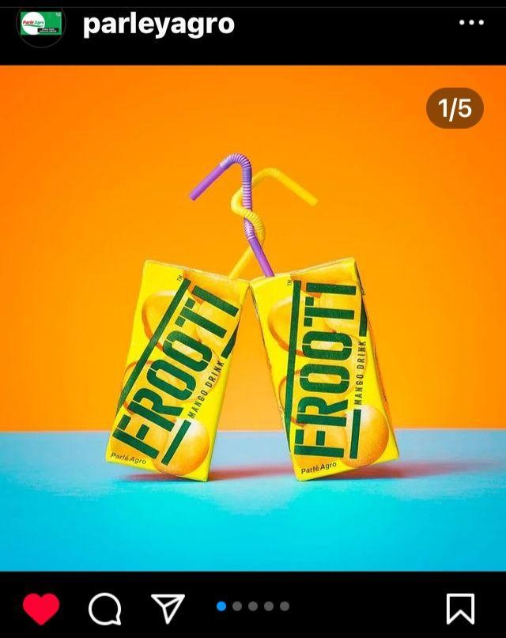
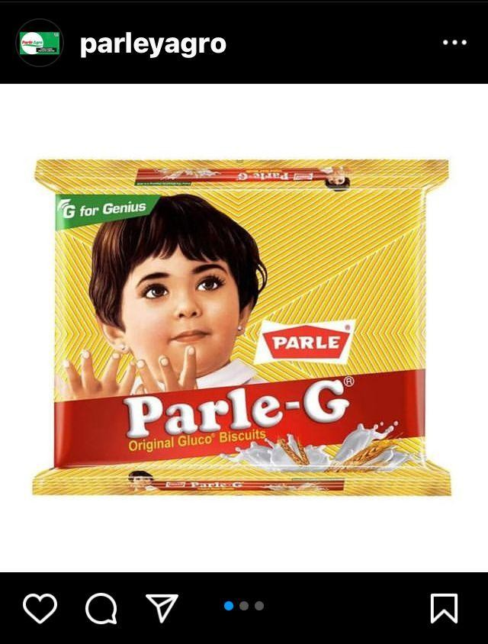
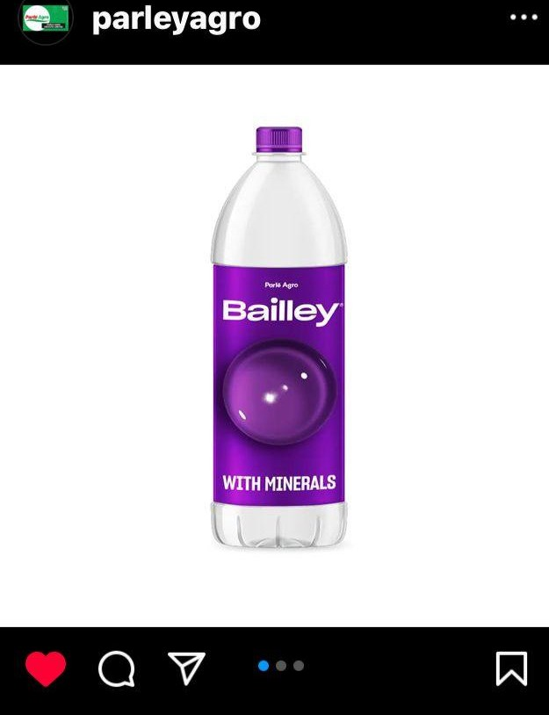
POST CREATION :-

Slide 35
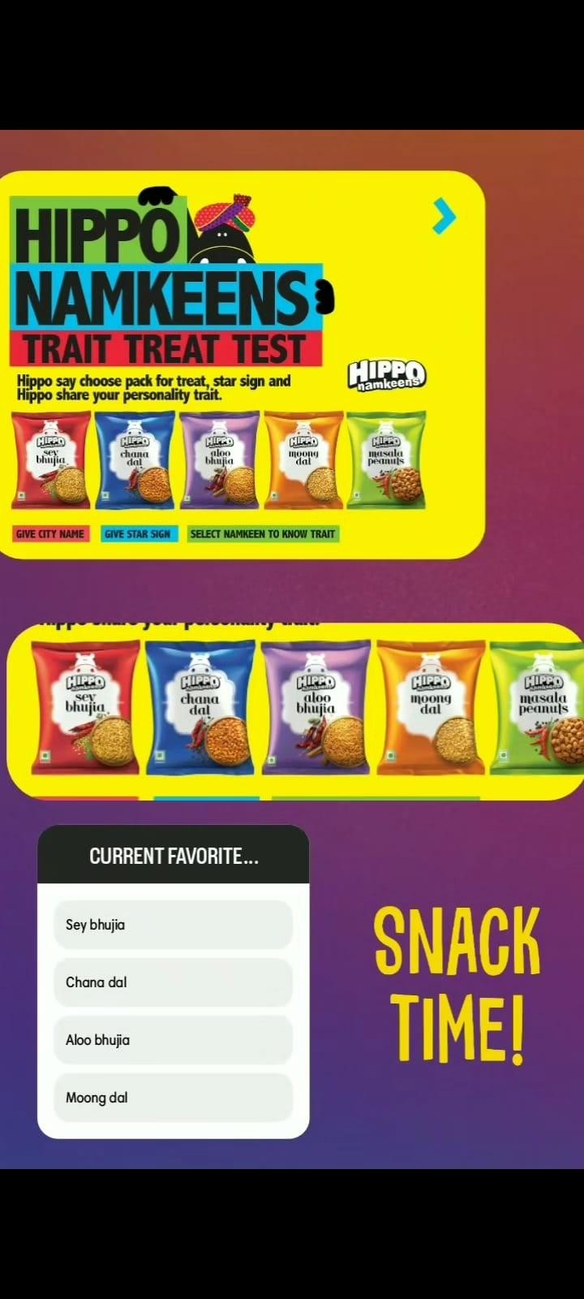
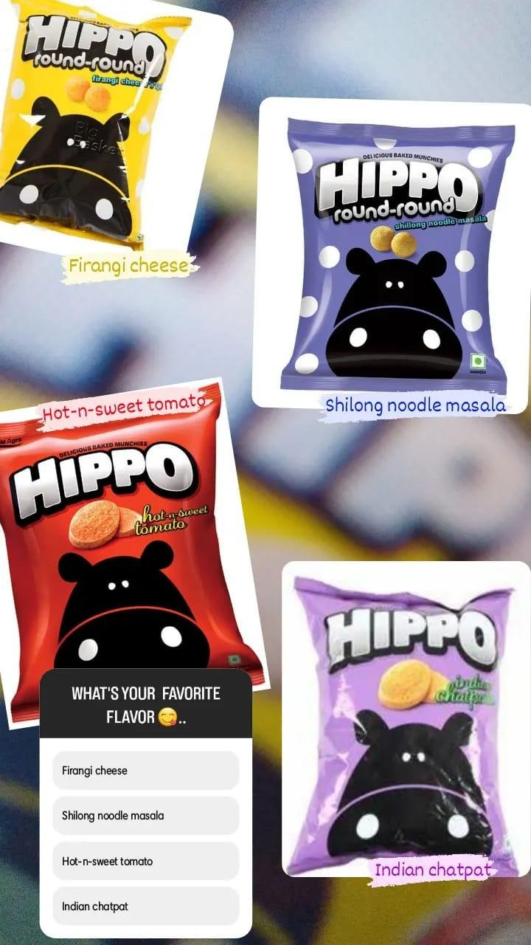
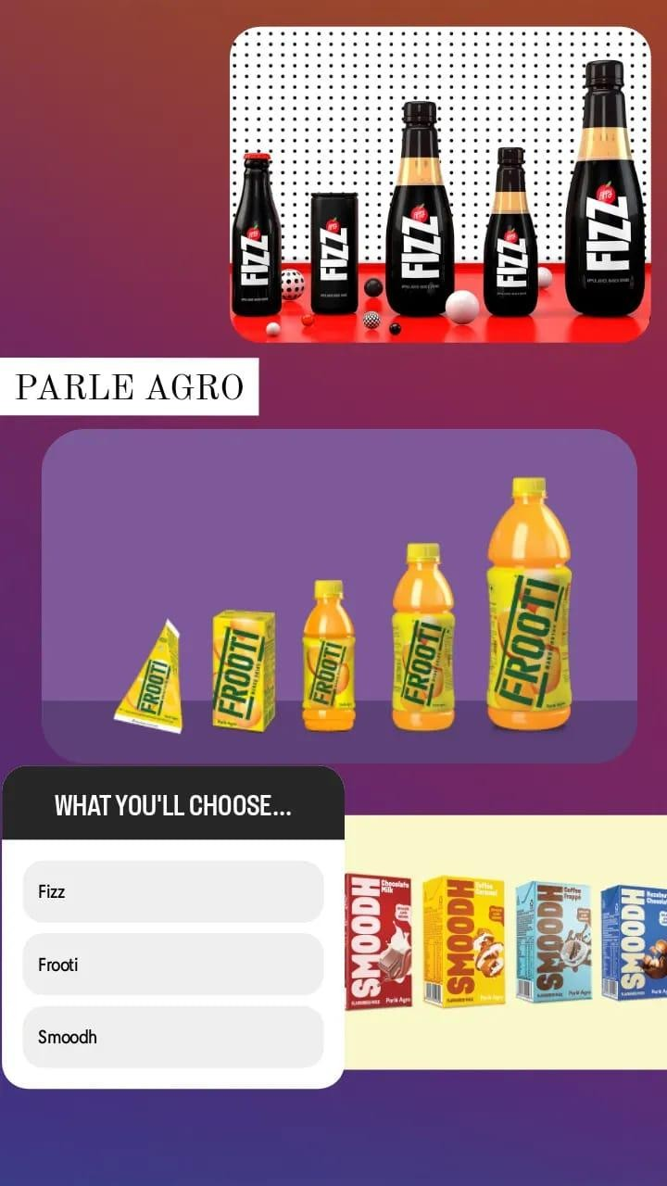
INSTAGRAM STORY

Slide 36
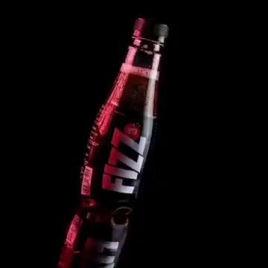
Designs/Video Editing

Slide 37
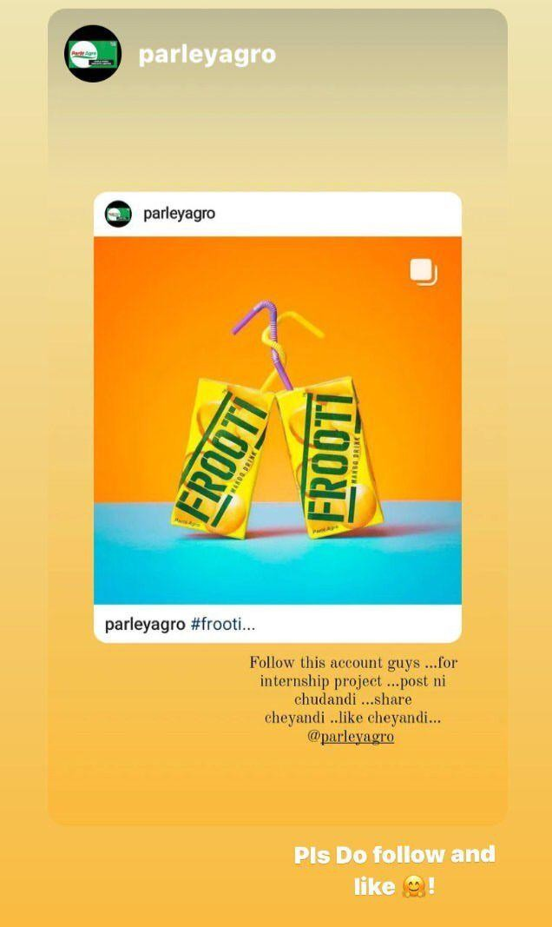
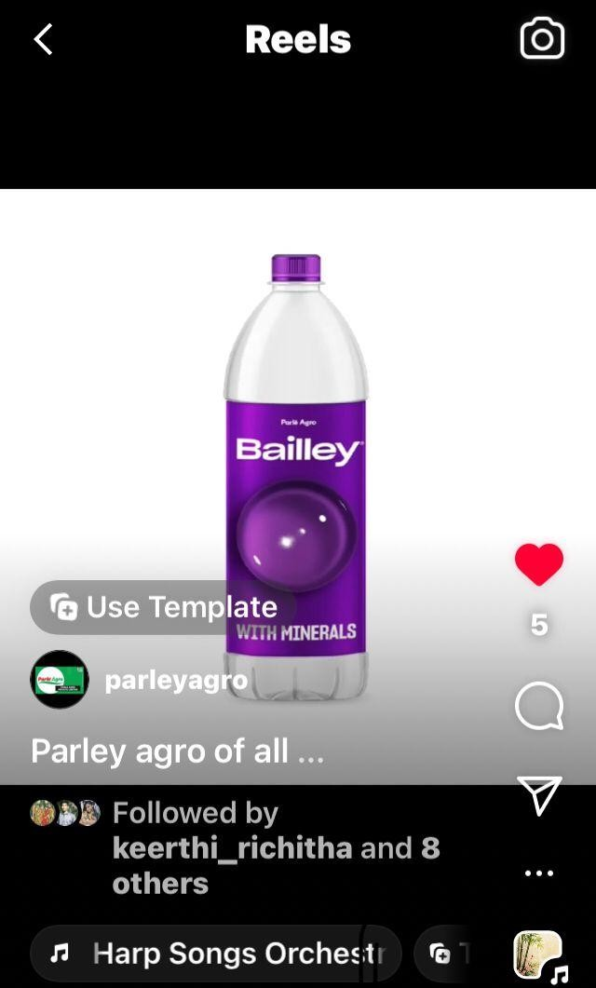
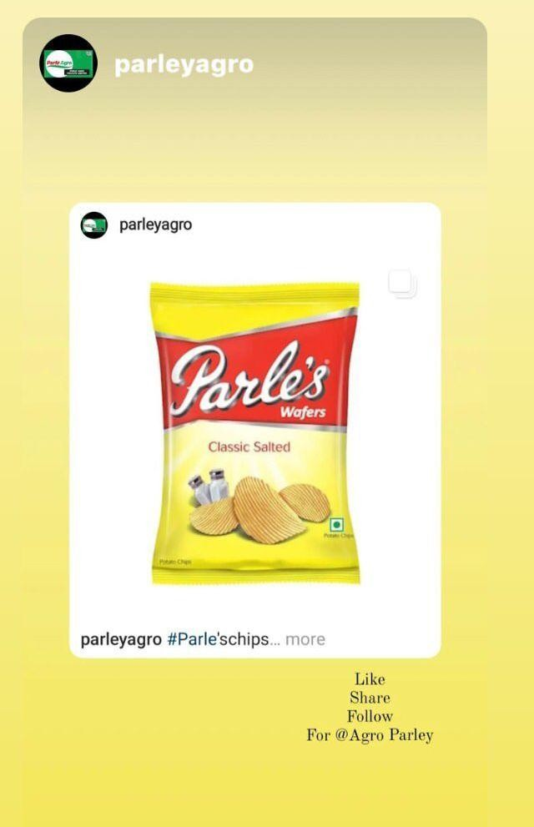
SOCIAL MEDIA Ad CAMPAIGNS
Ad Campaigns over Social media :-

Slide 38
Part 4: Content Creation and Curation (Post creations, Designs/Video Editing, Ad Campaigns over Social Media and Email Ideation and Creation)
Advertising Goals:
○
Advertising goals that Parle Agro might have pursued:
Brand Awareness: Creating and increasing brand awareness is a common advertising goal for any company, especially in the competitive food and beverage industry. The aim is to make consumers familiar with their products and ensure the brand is recognized and recalled easily.
Product Promotion: Advertising can focus on promoting speciﬁc products in the Parle Agro portfolio. For example, launching new ﬂavors or variants of existing products, or highlighting the unique features and beneﬁts of their beverages.
Market Expansion: If Parle Agro aims to expand into new regions or countries, advertising plays a crucial role in introducing their products to the new target audience and gaining a foothold in those markets.
Consumer Engagement: Building a connection with consumers through interactive advertising campaigns can lead to increased loyalty and customer retention. Social media campaigns and contests, for instance, can encourage consumer engagement.

Slide 39
AUDIENCE TARGETING -
The target audience of Parle Agro's products can be broadly categorized as follows:
❏ Children and Youth: Frooti, Appy Fizz, and Hippo snacks are popular among children and young adults due to their appealing ﬂavors and packaging.
❏ Urban and Semi-Urban Consumers: Parle Agro's products are widely available in urban and semi-urban areas, making them accessible to consumers in these regions.
❏ Middle-Class Families: The affordability and diverse range of products make them attractive to middle-class families looking for affordable and tasty beverages and snacks.
❏ Health-Conscious Consumers: With an increasing focus on healthier options, Parle Agro has introduced products like Frooti Fizz, which caters to health-conscious consumers looking for low-sugar and natural fruit-based beverages.
❏ On-the-go Consumers: Products like Frooti and Appy Fizz are popular choices among
consumers who prefer convenient on-the-go beverages.

Slide 40
Email Ad Campaigns
Email ad campaigns, also known as email advertising campaigns or email marketing campaigns, are a
marketing strategy used by businesses and organizations to promote their products, services, or
events through email communication. These campaigns involve sending targeted and personalized
emails to a group of recipients, typically existing customers, potential customers, or subscribers who
have opted in to receive communications from the sender.
Key elements of email ad campaigns include:
Objective: Deﬁning a clear goal for the campaign, such as increasing sales, promoting a new product, driving traﬃc to a website, or building brand awareness.
Audience Segmentation: Dividing the email list into different segments based on various criteria, such as demographics, purchase history, interests, or engagement level. Segmentation allows for more personalized and relevant content delivery.
Content Creation: Crafting compelling and engaging content for the emails, including catchy subject lines, persuasive body copy, and appealing visuals (images or videos).
Call-to-Action (CTA): Including a clear and actionable CTA that encourages recipients to take the desired action, such as clicking a link, making a purchase, or signing up for an event.

Slide 41
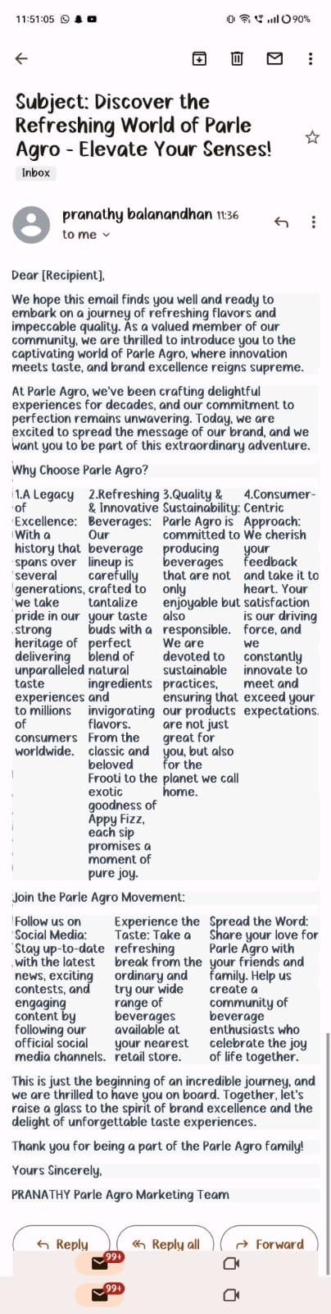
Email Ad Campaign 1 - Brand Awareness
Brand awareness through email can be an effective way to reach a wide
audience and promote your brand. Here are some steps and strategies to
consider when designing your email ad campaign:
1.Deﬁne Your Goals: Before you start, clearly deﬁne your objectives for the
campaign. Is it to introduce your brand to a new audience, remind existing
customers about your brand, or promote a new product or service?
Understanding your goals will guide the rest of your campaign.
2.Build a Quality Email List: Ensure you have a permission-based email list
with subscribers who have opted to receive communications from your
brand. Growing your list organically will lead to better engagement and avoid
potential legal issues.
3.Personalization and Segmentation: Segment your email list based on
various factors like demographics, past interactions, or interests.
Personalize the emails to cater to each segment's speciﬁc preferences and
needs, making them more relevant and engaging.

Slide 42
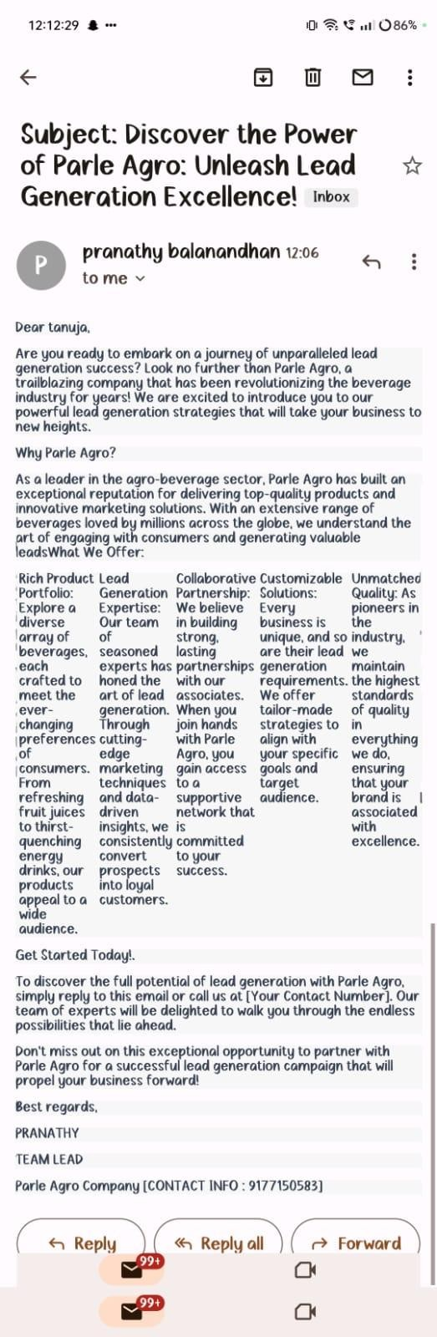
Email Ad Campaign 2 - Lead generation
When it comes to lead generation, regardless of the industry or company, the
primary goal is to attract potential customers and convert them into leads,
which can then be nurtured into becoming paying customers. Here are some
general lead generation strategies that companies, including Parle Agro, may
have employed:
1.Content Marketing: Creating high-quality and valuable content that
resonates with the target audience can be an effective lead generation tactic.
This could include blog posts, videos, infographics, and other engaging
content.
2.Social Media Marketing: Leveraging various social media platforms to build
brand awareness, engage with the audience, and drive traﬃc to the
company's website or landing pages.
3.Email Marketing: Building and maintaining an email list to communicate
directly with potential customers, share updates, and offer promotions or
incentives to convert leads.

Slide 43
THE CHALLENGES FACED :-
Some of the common challenges faced by Parle Agro and other companies in the sector include:
Intense competition: The beverage industry is ﬁercely competitive with numerous established
and emerging players. Parle Agro faces constant pressure to differentiate its products and
maintain market share amidst strong competition from multinational giants and local brands.
Changing consumer preferences: Consumer tastes and preferences are constantly evolving.
Parle Agro needs to adapt and innovate to meet the changing demands of consumers, including
trends towards healthier and more natural products, functional beverages, and sustainability.
Supply chain complexities: Managing a complex supply chain for sourcing raw materials, production, distribution, and retailing can be challenging. Ensuring the availability of products, minimizing inventory costs, and optimizing logistics are crucial tasks for the company.
Regulatory compliance: The food and beverage industry is subject to various regulations related to product quality, safety, labeling, and environmental standards. Compliance with these regulations can be demanding and requires continuous monitoring and adherence.
Marketing and advertising: Effectively marketing beverages in a crowded market can be challenging. Parle Agro needs to develop creative marketing campaigns to build brand awareness and capture the attention of consumers.

Slide 44
MEASURES TO OVERCOME THE CHALLENGES:-
Here are some possible measures:
★ Diversiﬁcation of Product Portfolio: Parle Agro can consider expanding its product range to cater to a wider consumer base. By introducing new ﬂavors, healthier options, or different beverage categories, they can stay relevant and attract new customers.
★ Market Research and Consumer Insights: Conducting extensive market research and analyzing consumer preferences and trends can help Parle Agro identify changing market demands and adapt its products accordingly.
★ Innovation and New Product Development: Investing in research and development to innovate and create new products can give Parle Agro a competitive edge. This could include developing beverages with unique ﬂavors, functional beneﬁts, or eco-friendly packaging.
★ Marketing and Branding: Strengthening marketing efforts and brand visibility can help Parle Agro maintain or increase its market share. Engaging in social media marketing, inﬂuencer collaborations, and targeted advertising can enhance brand awareness
★ Distribution Network: Improving the distribution network to reach more regions and remote areas can help increase market penetration and sales.

